Slide 1
Controlled Experiments
Lecture 15

Slide 2
Quantifying Usability
Usability: how well users can use the system’s functionality
Dimensions of Usability
Learnability
Efficiency
Errors
Satisfaction
Visibility

Slide 3
How do you decide if an interface is good?
Do you like my interface?
This is a useful interface. Agree/ Disagree
How much do you like my interface?
Which question is better?
Please the experimenter bias

Slide 4
Getting beyond “do you like my interface?”
What’s the comparison?
What’s the yardstick?

Slide 5
“iPad is better than Kindles”

Slide 6
“iPad is better than Kindles”
Is it testable hypothesis?
Broad questions are not testable.
Broad questions can be investigated by posing multiple narrow testable questions

Slide 7
Is it testable hypothesis?
NO
What feature?
What task?
What measurement?
What population?

Slide 8
Is it testable hypothesis?
NO
What feature? keyboard
What task? typing
What measurement? speed
What population? College students

Slide 9
“College students (population) type (task) faster (measurement) using iPad’s keyboard (feature) than using Kindle’s keyboard”

Slide 10
Experimental evaluation
controlled evaluation of specific aspects of interactive behaviour
evaluator chooses hypothesis to be tested
a number of experimental conditions are considered which differ only in the value of some controlled variable.
changes in behavioural measure are attributed to different conditions

Slide 11
Experimental factors
Subjects
who – representative, sufficient sample
Variables
things to modify and measure
Hypothesis
what you’d like to show
Experimental design
how you are going to do it

Slide 12
Variables
independent variable (IV)
characteristic changed to produce different conditions
e.g. interface style, number of menu items
dependent variable (DV)
characteristics measured in the experiment
e.g. time taken, number of errors.

Slide 13
Hypothesis
prediction of outcome
framed in terms of IV and DV
e.g. “error rate will increase as font size decreases”
null hypothesis:
states no difference between conditions
aim is to disprove this
e.g. null hyp. = “no change with font size”

Slide 14
Hypothesis
One Tailed Hypothesis
Two Tailed Hypothesis
When the outcome could go either way

Slide 15
How many subjects do we need?
Depends on how diverse the population is
How do we know we have enough subjects?
At the very least when there’s statistical significance

Slide 16
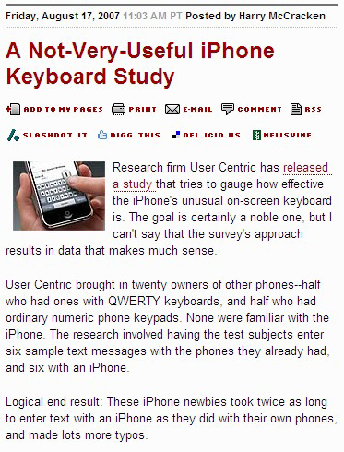

Slide 17
What was the problem with the study?

Slide 18
Procedure
Design
State a lucid, testable hypothesis
Identify the dependent & independent variable's
Design the experimental protocol
Choose the user pop^{n}
Run
Run pilot participants
Modify & finalize the experimental protocol
Run experiment
Analyze
Perform statistical analysis
Draw conclusion
Communicate results

Slide 19
Concerns Driving Experiment Design
Internal Validity
Are observed results actually caused by the independent variables?
External Validity
Can observed results be generalized to the world outside the lab?
Reliability
Will consistent results be obtained by repeating the experiment

Slide 20
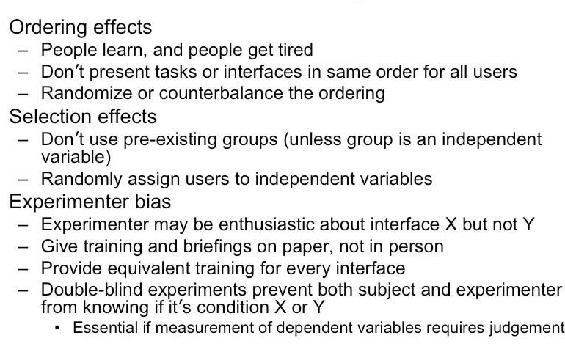
Threats to Internal Reliability

Slide 21
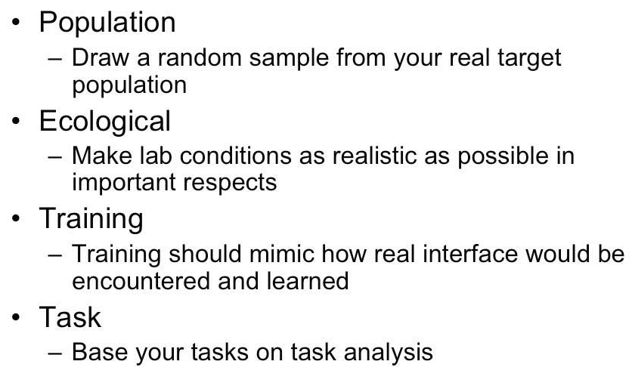
Threats to External Validity

Slide 22
Experimental design

Slide 24
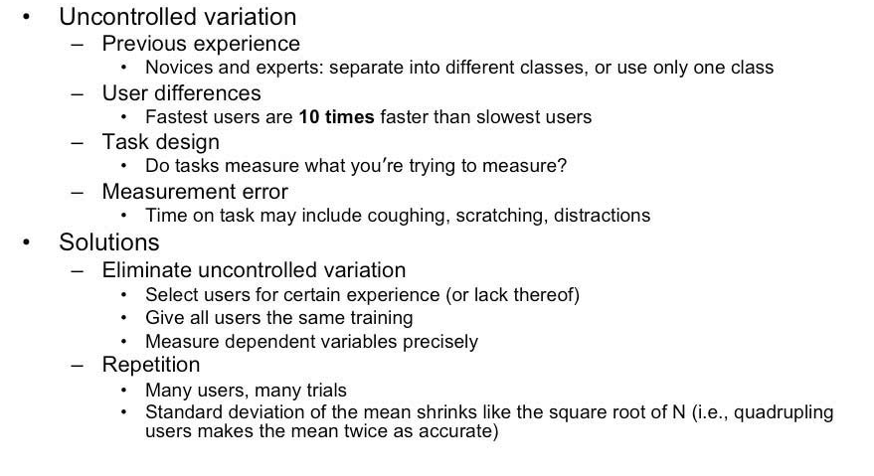
Threats to Reliability

Slide 25
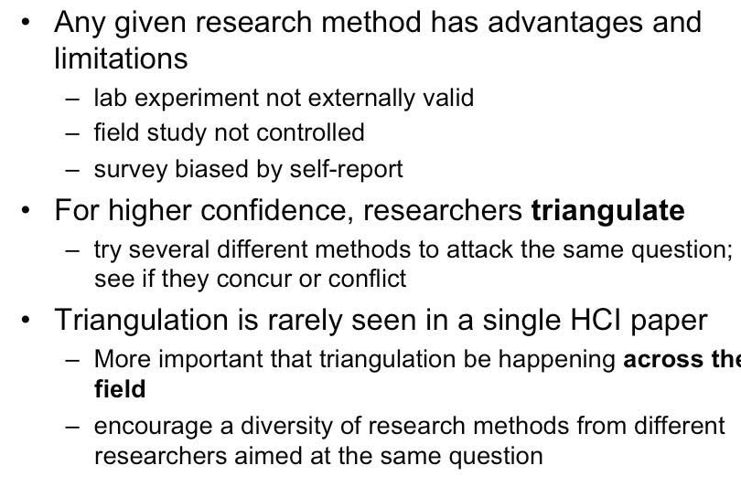
Triangulation

Slide 26
Informed Consent: Content
Purpose of the research Study
What you will be asked to do in the study
Time Required
Risks and Benefits
Compensation
Confidentiality
Voluntary participation
Right to withdraw from study
Whom to contact for questions about the study
Whom to contact about your rights as a research participant in this study
Agreement signatures

Slide 27
Why pilot test?
There are always unexpected problem.
It’s not too late to make chances to the experimental protocol.
Get a feel whether the hypothesis can be verified
It’s not too late to stop the experiment if results don’t seem promising.

Slide 29
Are there outliers?
Are there junk or missing data?
Some participants may have fallen asleep
Some participants may do random things just to earn the money
Recoding devices may have failed a couple times

Slide 32
Statistical Questions
Descriptive questions (What)
What is the typical performance?
How large are the differences between individuals? •
Analytical questions (yes or no)
Is there a difference?
Is the difference large or small?
Is the difference significant or due to chance?

Slide 33
Descriptive statistics (what)
Mean
Median
Standard deviation
Analytical statistics (yes or no)
T-test (When comparing two things)
ANOVA (when we have multiple conditions)

Slide 34
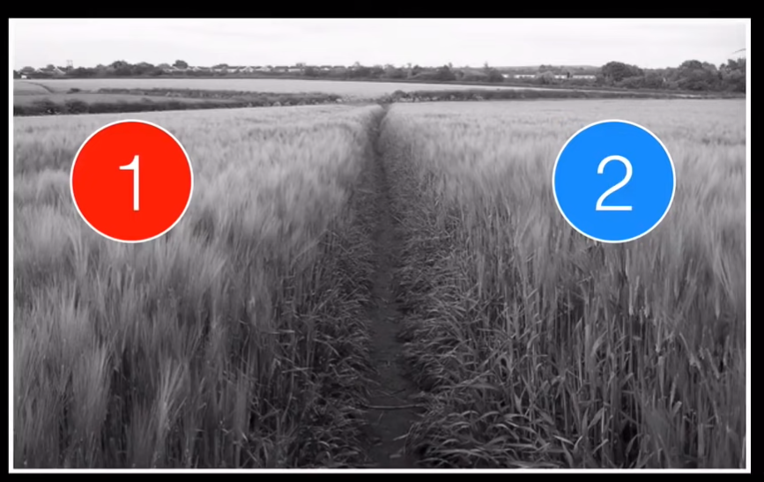

Slide 35
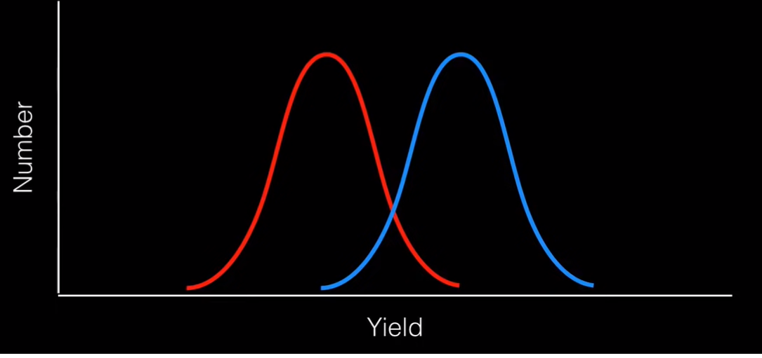
Which field has higher yield

Slide 36
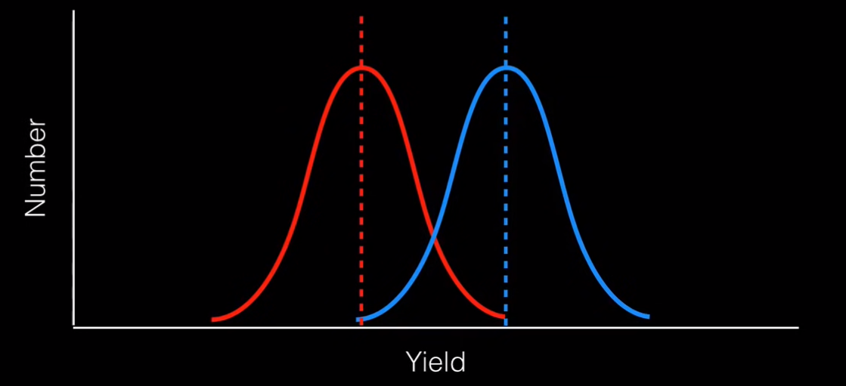
Average
Average of field 2 is higher

Slide 37
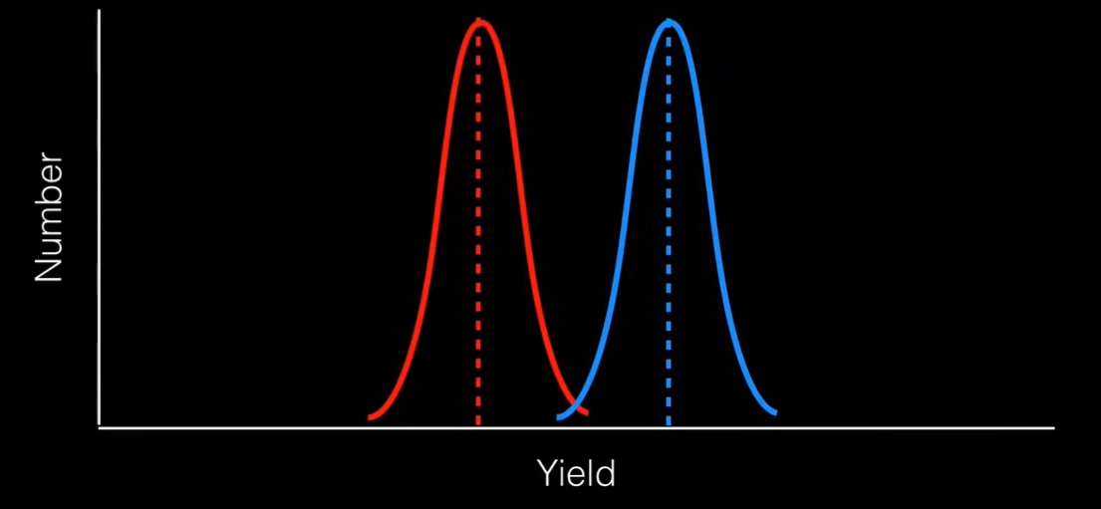

Slide 38
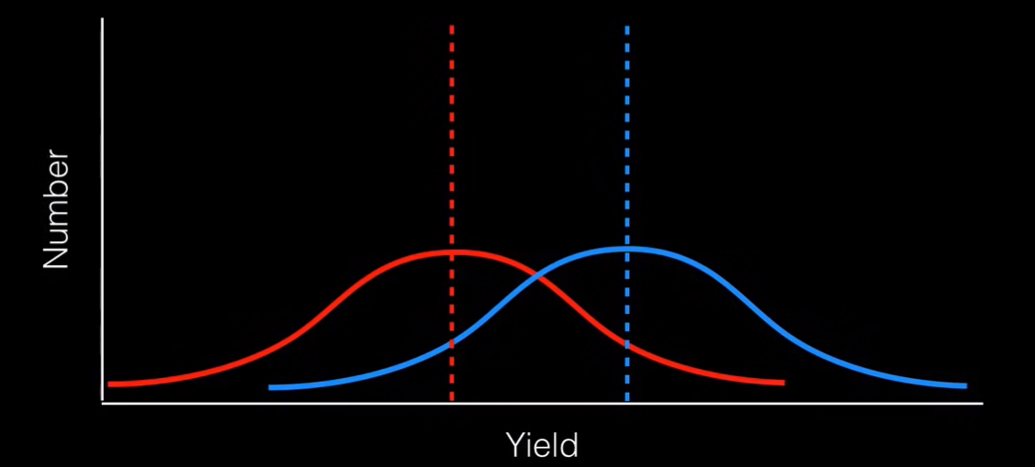
Depending on variance there could be a statistically significant difference or not.

Slide 39
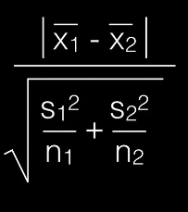
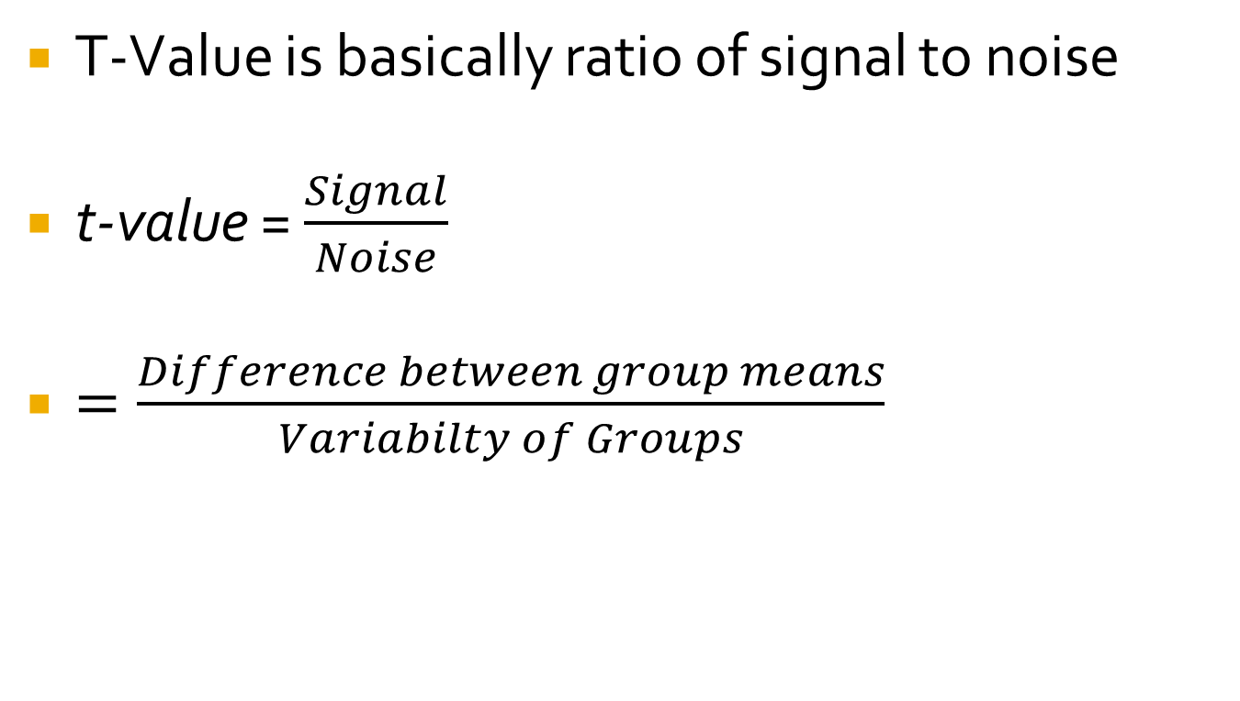
T-Value
T-Value is basically ratio of signal to noise
t-value = $\frac{Signal}{Noise}$
$=\frac{Difference between group means}{Variabilty of Groups}$
https://www.youtube.com/watch?v=pTmLQvMM-1M&t=483s
Notes:
S is standard deviation
Squared s is variance

Slide 40
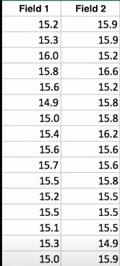
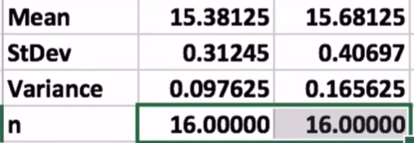
Mean of Sample 2
X1 is mean of sample 1
S is standard deviation
Square of S is variance
To calculate the t-value we first calculate all these values
https://www.youtube.com/watch?v=pTmLQvMM-1M&t=483s

Slide 41
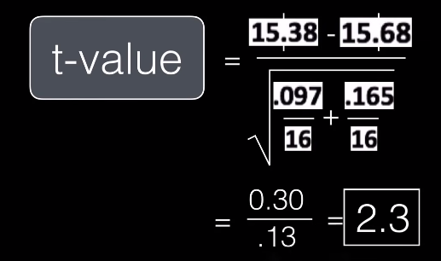
T-value
https://www.youtube.com/watch?v=pTmLQvMM-1M&t=483s

Slide 42
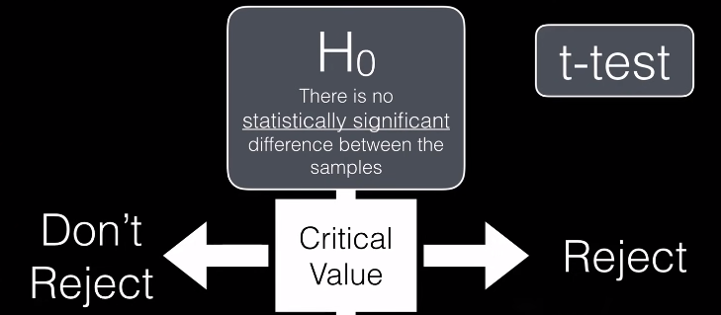
T-Test
https://www.youtube.com/watch?v=pTmLQvMM-1M&t=483s

Slide 43
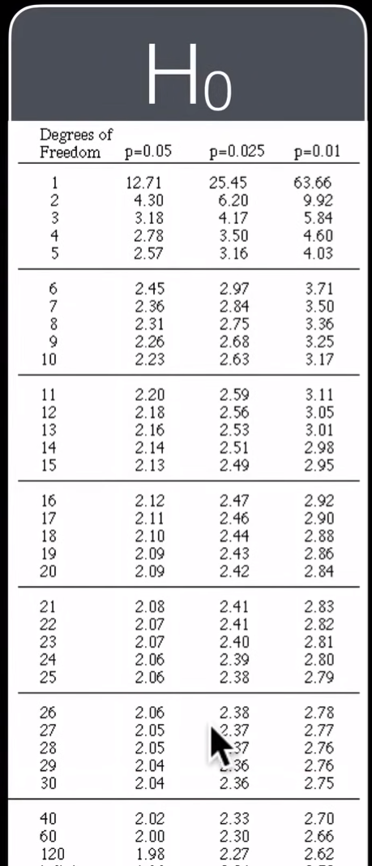
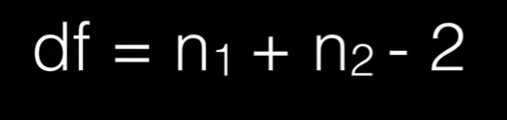
Look up Critical Value
Degrees of Freedom (df)
https://www.youtube.com/watch?v=pTmLQvMM-1M&t=483s

Slide 44
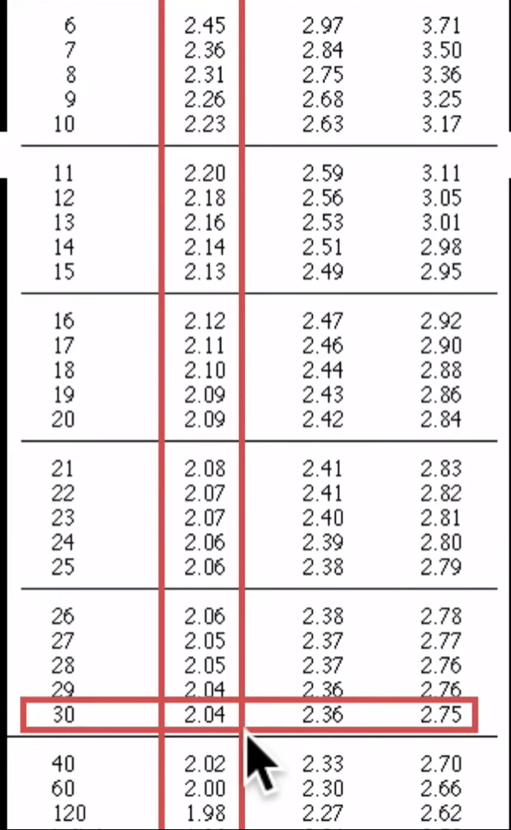
T-Test
Df = 30
T-value was 2.3
2.3> 2.04
So we can reject H₀
https://www.youtube.com/watch?v=pTmLQvMM-1M&t=483s

